Slide 1

CSE- 321
Software Engineering
Lecture: 10 System modeling and UML
Fahad Ahmed
Lecturer, Dept. of CSE
E-mail: fahadahmed@uap-bd.edu

Slide 2
Lecture Outlines
Model
System Modeling
UML-Building Blocks
UML : Diagrams
Class Diagram
Object Diagram
Use case Diagram
UML Tools

Slide 3
System Modeling
What is model?
Model is a simplification of reality.
A model is an abstraction of some aspect of an existing or planned system.
Blueprint of the actual system.
Specify the structural and behavior of the system.
Templates for designing the system.

Slide 4
System Modeling
Modeling is a central part of all the activities that lead to the development of good software.
We build models to
To Communicate the desired structure and behavior of our system.
To visualize and control the systems architecture.
To better understanding the system we are building often exposing opportunities for simplification and reuse.
To manage risk.
Modeling is a proven and well accepted engineering tech.

Slide 5
Why Model ?
System Modeling
Analyse the problem-domain
simplify reality
capture requirements
visualize the system in its entirety
specify the structure and/or behaviour of the system
Design the solution
document the solution - in terms of its structure, behaviour, etc.

Slide 6
Why Model ?
System Modeling
Modeling achieves four aims:
Helps you to visualize a system as you want it to be.
Permits you to specify the structure or behavior of a system.
Gives you a template that guides you in constructing a system.
Documents the decisions you have made.
You build models of complex systems because you cannot comprehend such a system in its entirety.
You build models to better understand the system you are developing.
Notes:
According to Booch in The Unified Modeling Language User Guide, modeling achieves four aims:
1. Models help you to visualize a system, as you want it to be. A model helps the software team communicate the vision for the system being developed. It is difficult for a software team to have a unified vision of a system that is described only in specification and requirement documents. Models bring about understanding of the system.
2. Models permit you to specify the structure of behavior of a system. A model allows how to document system behavior and structure before coding the system.
3. Models give a template that guide you in constructing a system. A model is an invaluable tool during construction. It serves as a road map for a developer. Have you experienced a situation where a developer coded incorrect behavior because he or she was confused over the wording in a requirements document? Modeling helps alleviate that situation.
4. Models document the decisions you’ve made. Models are valuable tools in the long term because they give “hard” information on design decisions. You don’t need to rely on someone’s memory.
Sell the students on the value of visual modeling.
Clarify that you are discussing formal modeling, not modeling written on a white board or on the back of a napkin at lunch.

Slide 7
System Modeling
Principles of Modeling
First principle of modeling:
The choice of what models to create has a profound influence on how a problem is attacked and how a solution is shaped.
Second principle of modeling:
Every model may be expressed at different levels of precision
Notes:
According to Grady Booch, IBM Fellow, a model provides the blueprints of a system. Models may encompass detailed plans, as well as more general plans that give a 30,000-foot view of the system under construction. A good model includes those elements that are not relevant to the given level of abstraction. Every system may be described from different aspects using different models, and each model is therefore a semantically closed abstraction of the system. A model may be structural, emphasizing the organization of the system, or it may be behavioral, emphasizing the dynamics of the system.
Define what is meant by the term “model.”

Slide 8
System Modeling
Principles of Modeling
Third principle of modeling:
The best models are connected to reality.
Fourth principle of modeling:
No single model is sufficient. Every non-trivial system is best approached through a small set of nearly independent models.
Notes:
According to Grady Booch, IBM Fellow, a model provides the blueprints of a system. Models may encompass detailed plans, as well as more general plans that give a 30,000-foot view of the system under construction. A good model includes those elements that are not relevant to the given level of abstraction. Every system may be described from different aspects using different models, and each model is therefore a semantically closed abstraction of the system. A model may be structural, emphasizing the organization of the system, or it may be behavioral, emphasizing the dynamics of the system.
Define what is meant by the term “model.”

Slide 9

The Importance of Modeling
System Modeling
A model is “a complete description of a system from a particular perspective.” A model is a simplification of reality.
Notes:
According to Grady Booch, IBM Fellow, a model provides the blueprints of a system. Models may encompass detailed plans, as well as more general plans that give a 30,000-foot view of the system under construction. A good model includes those elements that are not relevant to the given level of abstraction. Every system may be described from different aspects using different models, and each model is therefore a semantically closed abstraction of the system. A model may be structural, emphasizing the organization of the system, or it may be behavioral, emphasizing the dynamics of the system.
Define what is meant by the term “model.”

Slide 10
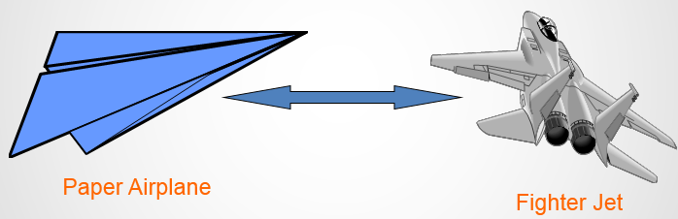
System Modeling
What are the advantages of creating a model?
Advantages: - Provides standard for software development. - Reducing of costs to develop diagrams of UML using supporting tools. - Development time is reduced. - The past faced issues by the developers are no longer exists. - Has large visual elements to construct and easy to follow.

Slide 11
System Modeling
System modeling is the process of developing abstract models of a system, with each model presenting a different view or perspective of that system.
System modeling has now come to mean representing a system using some kind of graphical notation, which is now almost always based on notations in the Unified Modeling Language (UML).
System modelling helps the analyst to understand the functionality of the system and models are used to communicate with customers.

Slide 12
Unified Modeling Language (UML)
The UML stands for Unified modeling language.
The UML is a language for
Visualizing
Specifying
Constructing
Documenting
the artifacts of a software-intensive system.
The Unified Modelling Language (UML) is an industry standard for object oriented design notation.
The Unified Modeling Language User Guide SECOND (2.0) EDITION
http://umlguide2.uw.hu/index.html

Slide 13

Unified Modeling Language (UML)
UML is not a programming language, it is rather a visual language.
We use UML diagrams to portray the behavior and structure of a system.
The UML builds models that are precise, unambiguous, and complete.
UML helps software engineers, businessmen and system architects with modelling, design and analysis.

Slide 14
Unified Modeling Language (UML)
The UML was developed in 1994-95 by Grady Booch, Ivar Jacobson, and James Rumbaugh at the Rational Software.
In 1997, it got adopted as a standard by the Object Management Group (OMG). This was the first version (V1.1) of UML. The OMG is best recognized for the Common Object Request Broker Architecture (CORBA) standards.
International Organization for Standardization (ISO) published UML as an approved standard in 2005.

Slide 15
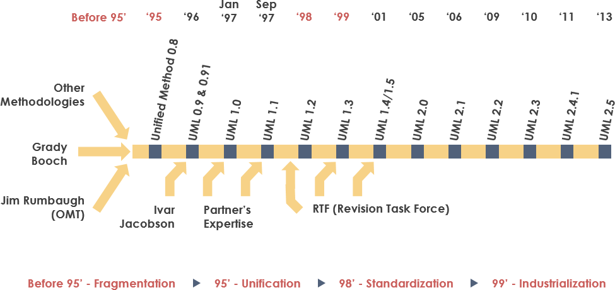
Unified Modeling Language (UML)

Slide 16

Thanks to All

